Slide 1
Research Data Management and Data Management Plans (DMP)
ELIXIR course 26th September 2022
Solveig Fossum-Raunehaug
Research Support Office

Slide 2
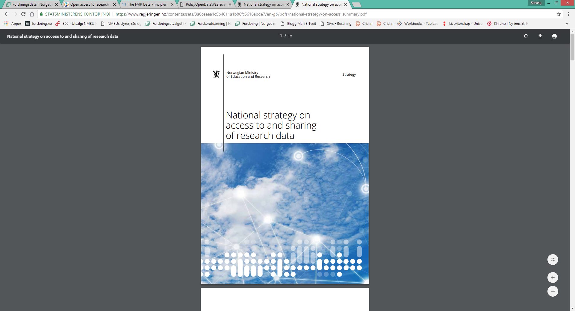
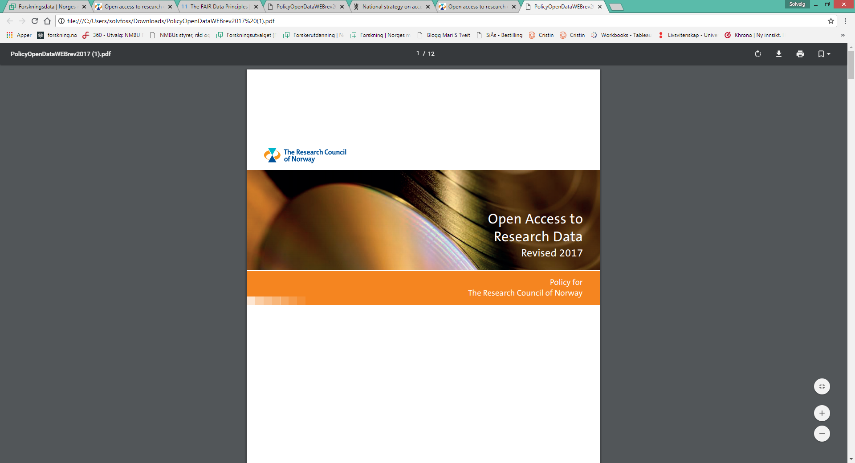
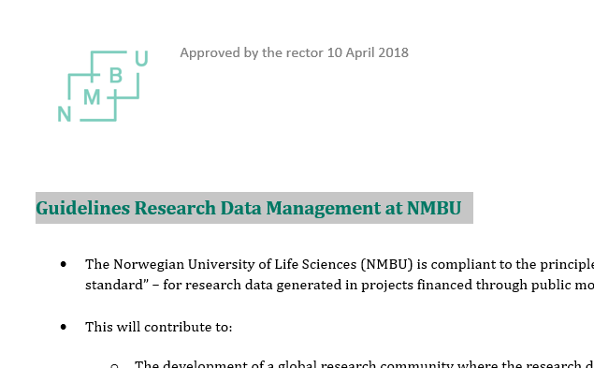
Policy and guidelines
National strategy on access to and sharing of research data (Ministry of Education and Research Aug 2017)
Policy for Open Access to Research Data (The Research Council of Norway Dec 2017)
Guidelines Research Data Management at NMBU (Apr 2018)
Notes:
Hovedregelen er at alle forskningsprosjekter Forskningsrådet finansierer som genererer data skal ha en datahåndteringsplan. Prosjektansvarlig må begrunne det spesielt dersom prosjektet ikke har en slik plan

Slide 3

Why Data Management Plan?
Requirements from the funding agencies (NFR, EU)
From July 2020 - all new PhD candidates at NMBU should have a Data Management Plan (DMP)
NMBU Guidelines for Research Ethics

Slide 4
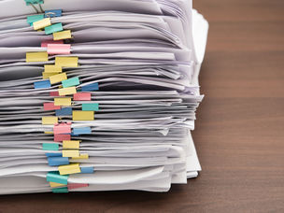
Data Management Plans (DMP) - tools
NMBU recommends students and employees to make use of:
The DMP made available at the Norwegian Centre for Research Data (NSD) (DMP+)
ELIXIR Data Stewardship Wizard might be used for research data management within life sciences.
Examples of national and international systems to generate DMPs:
National e-Infrastructure for Research Data (NIRD/Uninett Sigma 2) (easy DMP)
FAIRDOM Data Management
Digital Curation Senter - DMP online

Slide 5
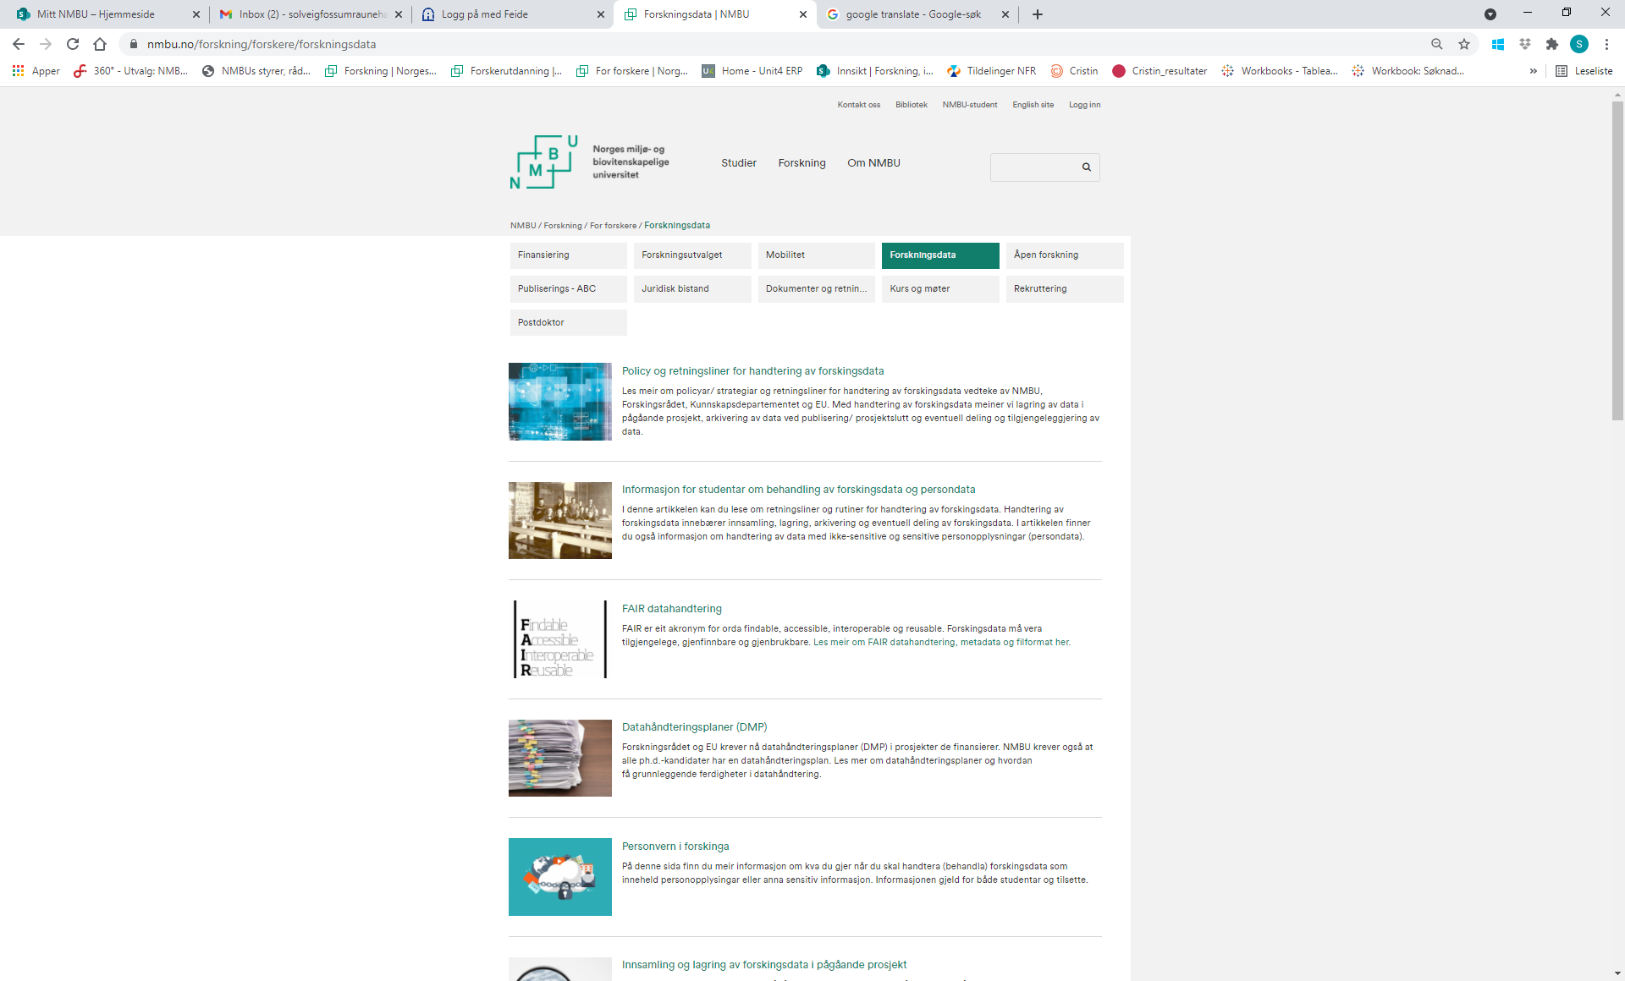
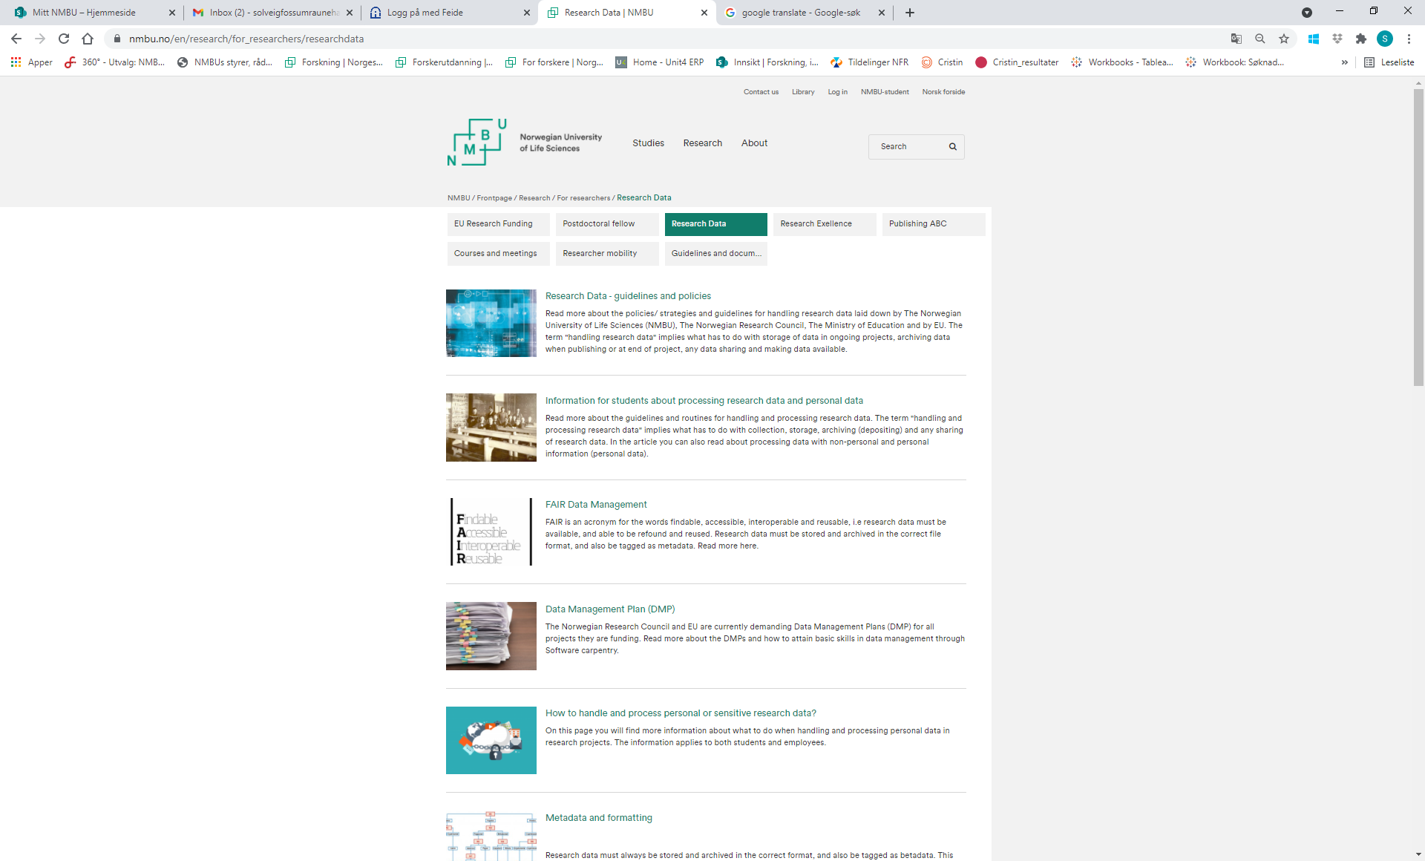
Webpages

Slide 6
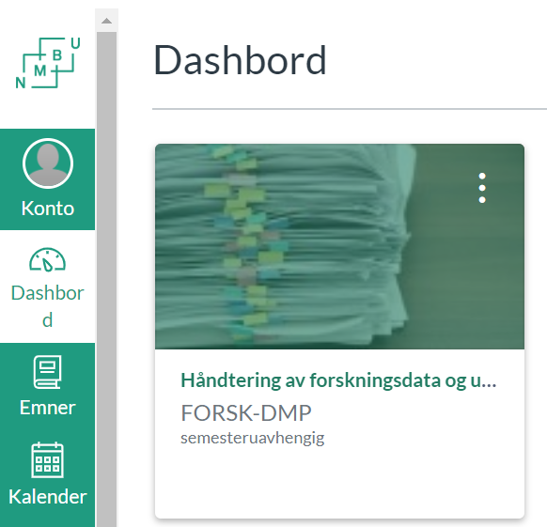
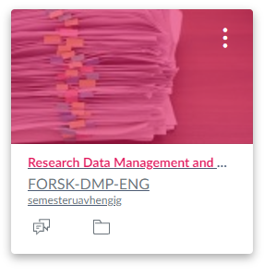
Canvas course
https://nmbu.instructure.com/courses/4825
https://nmbu.instructure.com/courses/6249
Data Management

Slide 7

Storage of Research Data - in ongoing projects

Slide 8
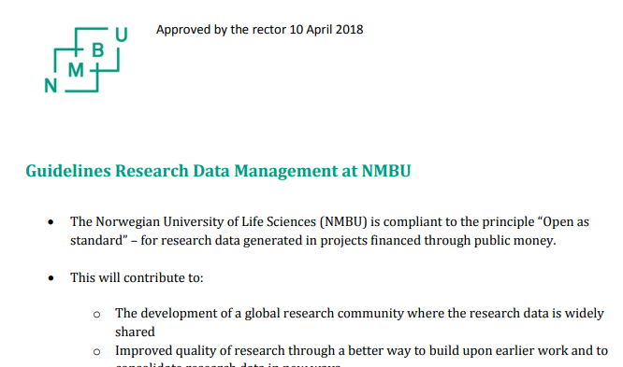
Storage of Research Data without personal information – what do the guidelines say?
Research Data (raw data) must be stored at the NMBU server or in approved servers nationally or internationally.
You might take out a copy of the raw data and store it at your OneDrive server or personal computer for processing and analyzes.
However, research data should NOT only be stored on a personal computer (C-drive), external hard drives, dropbox etc.

Slide 9

Storage of Research Data without personal information - tools
LargeFile
server W:
Research Data generated in ongoing projects should normally be stored at the LargeFile server (W:).
External cooperation (should not be used as the primary place for storage): Sharing data using Office365 and OneDrive – NMBU services

Slide 10
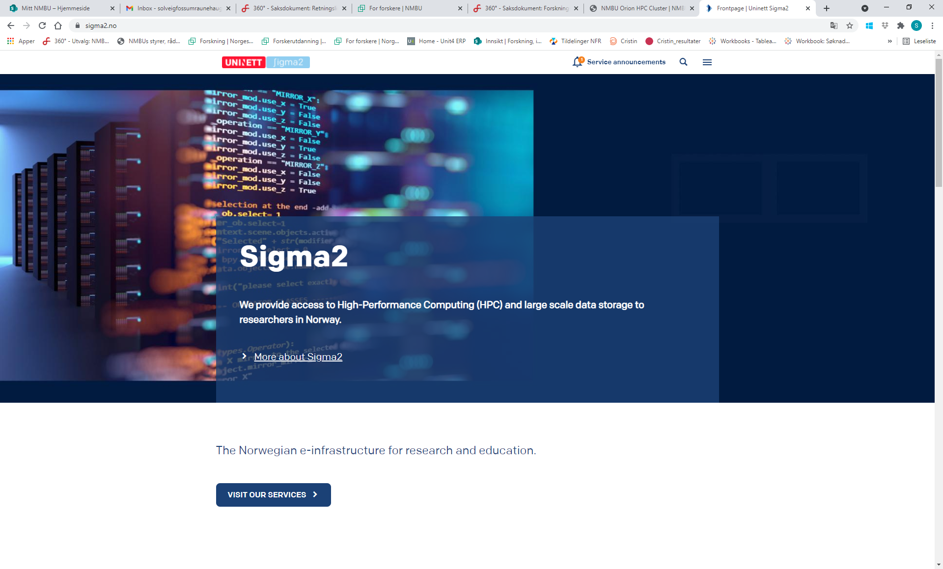
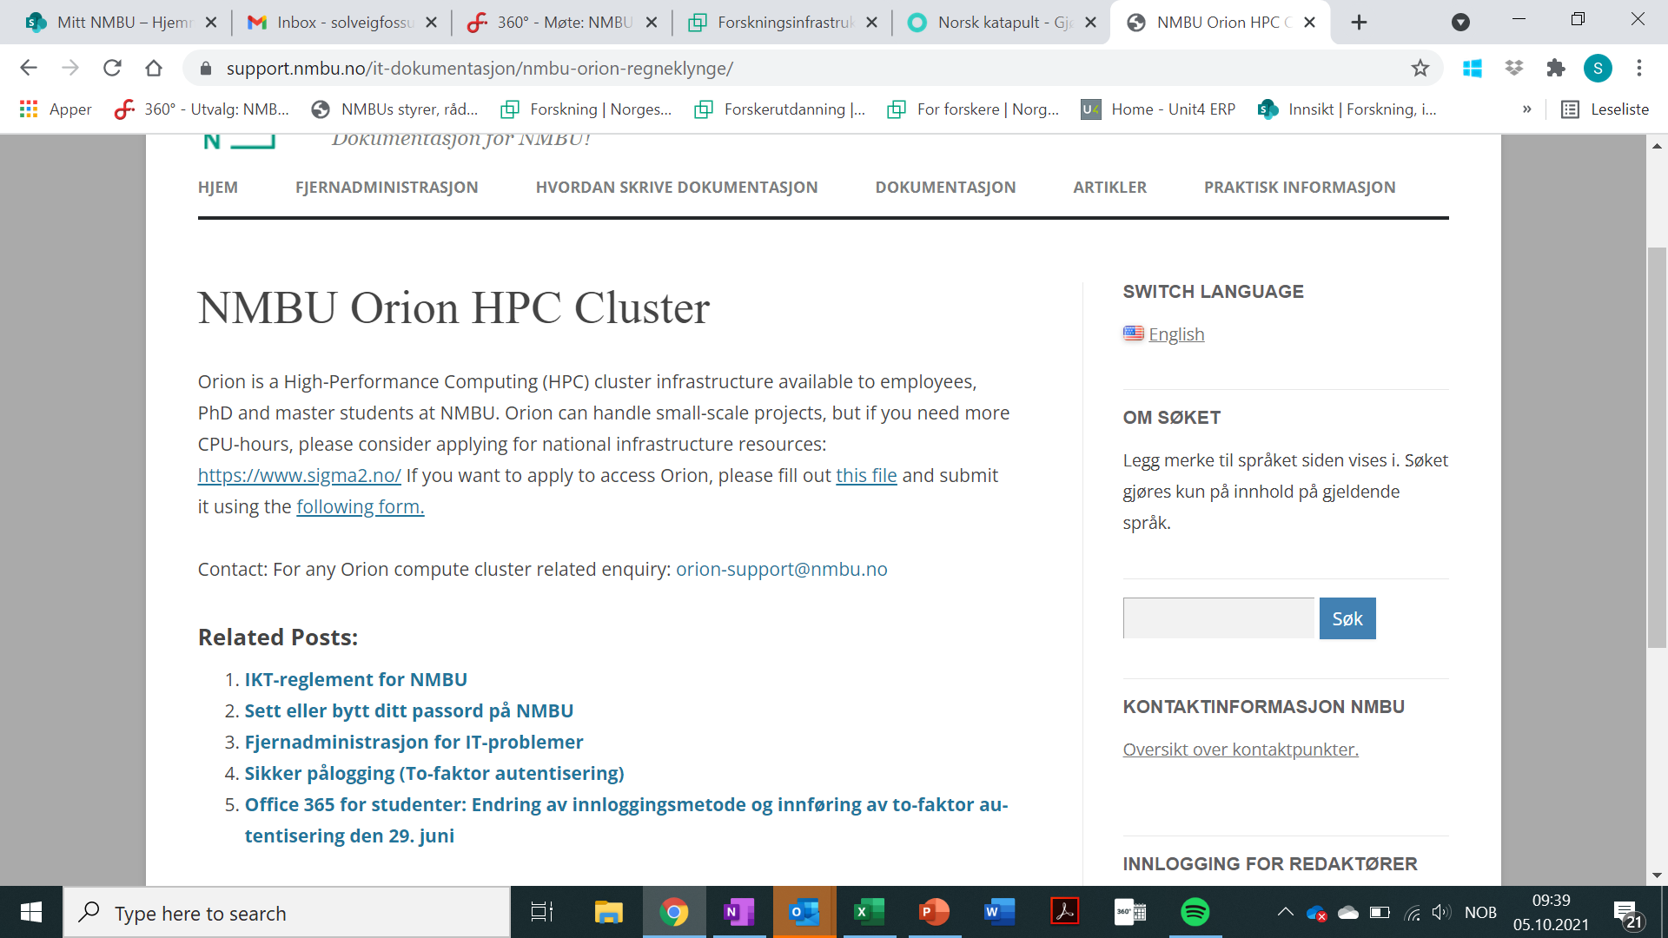
Storage and computing power (calculations) large datasets - tools
Orion-cluster at NMBU or
NIRD - UNINETT/ Sigma 2 service.

Slide 11

Archiving (Deposit) and Sharing Research Data

Slide 12
Archiving (Deposit) – what do the guidelines say?
Research data upon which scientific publications is based must be archived in domain specific, national or international data archives.
The data archives must be compliant to international standards (FAIR).
Recommendation - Do not deposit your data via journals!

Slide 13
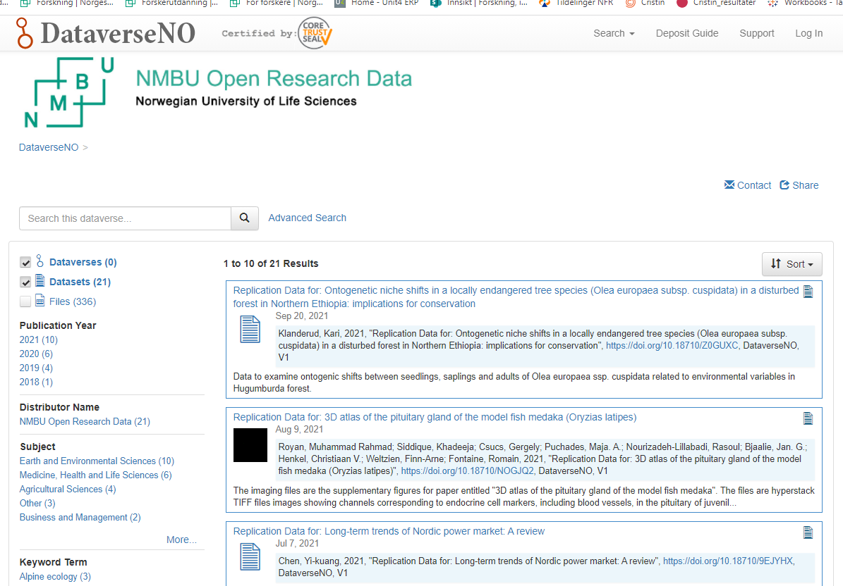
Archiving (Deposit) - services
The NMBU Data archive:
NMBU Open Research Data – NMBU service (University Library)
Examples of national data archives:
Norwegian Centre for Research Data (NSD) (all type of data)
National e-Infrastructure for Research Data (NIRD). Is operated by UNINETT/ Sigma2 (large data sets)
The Norwegian Bioinformatics Platform (NELS) og ELIXIR NO (biological and medical data)
Examples of international data archives:
re3data.org is a global registry of research data repositories that fulfil the FAIR principles
FAIRDOM helps you to be in control of collecting, managing, storing, and publishing your data, models, and operating procedures.
CESSDA - Consortium of European Social Science Data Archives provides large scale, integrated and sustainable data services to the social sciences.
DRYAD is a data sharing system.
Zenodo is a EU based data sharing system, widely used in humaniora.

Slide 14
Sharing Research Data
NMBU is compliant with the FAIR-principles (Findable, Accessable, Interoperable and Resuable) and the principle that
"Research data should be as open as possible, as closed as necessary"
Reasons for not sharing data:
Safety measures
Personal data/ personal information
Legal matters
Commercial provisions
Other conditions
«It should be known that you have a data set, but others should not necessarily have full open access to the (raw) data»
Data Management Plan (DMP)
Notes:
Gjelder kun offentlig finansierte data

Slide 15
If you are handling personal data in a research project – certain rules, guidelines and routines apply
www.nsd.no

Slide 16

Do you need personal data?
The first question to ask is
Could you manage your project without collecting personal data?
Have you explored alternatives?
Has anyone collected similar data to yours?

Slide 17
Notification form at NSD
Take test on NSDs webpage
If only one “yes” you must notify
NSD will ask for:
Purpose – why this study?
What kind of personal data do you collect?
Processing – what’s the plan?
Information letter
Interview guide
Erasing/ anonymizing data

Slide 18

Obligation to notify to NSD
If you are handling personal data in a research project you must notify NSD.
Notifying NSD ensures required documentation on handling personal data.
NSD is NMBU’s Data Protection Advisor and will be your guide.

Slide 19

Collection of personal data - tools
Nettskjema is the primary tool for collection of personal data such as surveys and interviews (Nettskjema Dictaphone)

Slide 20
Roles and responsibility
The project leader is:
PhD candidates
Employees at NMBU
Supervisor in student projects
Important to remember:
Is it necessary to have personal data?
According to GDPR?
Research ethics
Notification to NSD
Data Management Plan
Report any discrepancy

Slide 21


Summary NMBU guidelines
The project leader have filled in a Data Management Plan (DMP) at the start of a project (continuous process)
Data is stored at NMBU server or at national/ international platforms in ongoing projects.
Data is tagged with metadata.
Data is deposited in archives at the end of a project/ publication.
Data is made open and available when/ if possible.
Data is only stored at the local hard drive (C: disk).
Data is only stored at Office365
Data is only stored at an external hard drive.
Data is stored in Dropbox.

Slide 22
Questions and comments?

